Slide 1



Machine Learning
S. Sridhar and M. Vijayalakshmi

Slide 2
Chapter 2
Understanding of Data

Slide 3
What is Data?
DATA ARE FACTS
FACTS ARE IN THE FORM OF NUMBERS, AUDIO, VIDEO, IMAGE
NEED TO ANALYZE DATA FOR TAKING DECISIONS

Slide 4
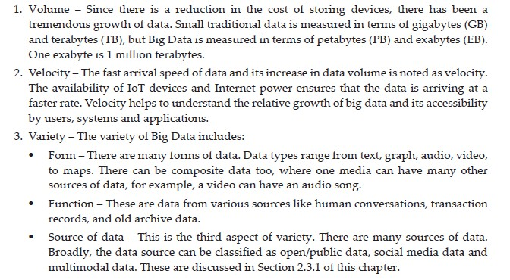
Characteristics of Big Data

Slide 5
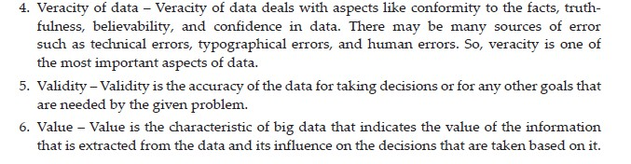
Characteristic of Data

Slide 6
Data Sources
A DATA SOURCE CAN BE ANYTHING –
STRUCTURED DATA
SEMI-STRUCTURED DATA
UNSTRUCTURED DATA

Slide 7
Structured Data
A STRUCTURED DATA CAN BE ANY ONE OF THE FOLLOWING –
Data that is well-organized in rows and columns
Follows a fixed schema (predefined format)
Easy to store, search, and analyze
Examples:
Student marks in an Excel sheet
Bank transaction tables
Employee records in a database
👉 Think of it like a neatly arranged attendance register

Slide 8
Unstructured Data
AN UNSTRUCTURED DATA CAN BE ANY ONE OF THE FOLLOWING –
Data with no predefined format
Harder to process directly
Makes up most of the real-world data.
Examples:
Images
Videos
Audio files
Social media posts
PDFs and text documents
👉 Like photos or voice notes — meaningful, but not organized.

Slide 9
SEMI-Structured Data
A SEMI-STRUCTURED DATA CAN BE ANY ONE OF THE FOLLOWING –
Data that is partially organized
Does not follow a strict table format, but has tags or keys
Examples:
JSON files
XML files
Emails (sender, receiver, subject + message body)
👉 Like a WhatsApp chat: some structure (time, sender) but free-text messages.

Slide 10
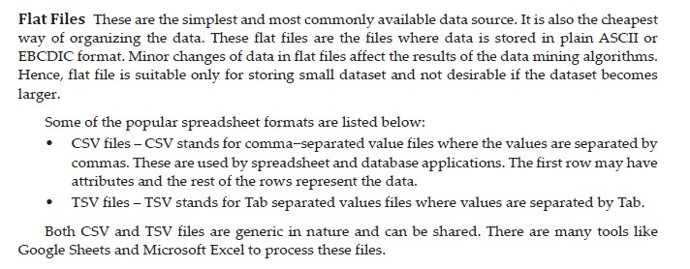
Data Storage

Slide 11
Data Storage
DATABASE SYSTEMS
TYPES ARE
TRANSACTIONAL DATABASE:-Handle day-to-day operations where data is frequently inserted, updated, or deleted.
TIME SERIES DATABASE:-Store data that is generated continuously over time.
TEMPORAL DATABASE:-Store historical data and track changes over time.

Slide 12
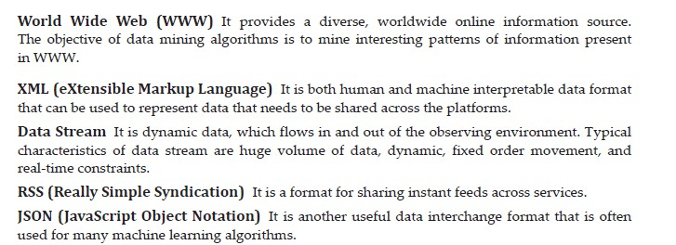
Data Storage
OTHER TYPES

Slide 13

Descriptive Analytics

Slide 14
Descriptive Analytics
Descriptive Analytics
Descriptive Analytics is about understanding and summarizing data.
It answers the question:
👉 “What has happened?”
After data is collected, descriptive analytics:
Organizes the data
Summarizes it
Converts raw data into meaningful information
It does not predict the future or explain why something happened.

Slide 15

Diagnostic Analytics

Slide 16
Diagnostic Analytics
👉 Problem:
Sales of a product have decreased.
Using diagnostic analytics, we ask:
Is the price too high?
Is there increased competition?
Are customers unhappy with quality?
Is marketing ineffective?
📌 The goal is not prediction, but finding reasons.
Another Example (Academic)
👉 Problem:
Student attendance is low.
Possible causes:
Difficult subject
Poor timetable
Lack of interest
Teaching methodology
Diagnostic analytics helps analyze which factor is responsible.

Slide 17

Predictive Analytics

Slide 18

Prescriptive Analytics

Slide 19
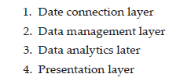
Data Analysis Framework
A data analysis framework is a step-by-step structure that explains how raw data is converted into useful insights.
It shows the flow of data from source to final decision-making.
The framework in this slide has four layers.

Slide 20
Data Connection Layer
👉 Purpose: Collect data from different sources.
What happens here?
Connects to data sources
Extracts raw data
Examples of Data Sources:
Databases (MySQL, Oracle)
Files (CSV, Excel)
Sensors / IoT devices
Web applications, APIs
📌 This layer answers: “Where is the data coming from?”

Slide 21
Data Management Layer
👉 Purpose: Store, clean, and organize data.
What happens here?
Data cleaning (removing duplicates, errors)
Data transformation
Data storage (Data warehouse / Data lake)
Examples:
ETL processes
Data preprocessing
Data integration
📌 This layer answers: “Is the data clean and ready?”

Slide 22
Data Analytics Layer
👉 Purpose: Analyze the data to find patterns and insights.
What happens here?
Statistical analysis
Descriptive, Diagnostic, Predictive analytics
Machine Learning models
Examples:
Trend analysis
Classification and prediction
Correlation analysis
📌 This layer answers: “What does the data tell us?”

Slide 23
Presentation Layer
👉 Purpose: Present insights in an easy-to-understand form.
What happens here?
Visualization of results
Dashboards and reports
Decision support
Examples:
Charts and graphs
Dashboards (Power BI, Tableau)
Reports
📌 This layer answers: “How do we explain the results?”

Slide 24
Types of Processing
Processing refers to how computing resources are used to store, manage, and process data.
Depending on the scale, speed, and requirement, different processing models are used.
This slide covers three important types of processing:
CLOUD COMPUTING
GRID COMPUTING
H-COMPUTING

Slide 25
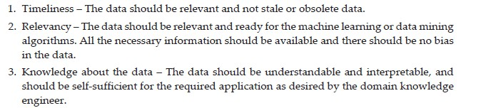
Good Data Characteristics
For any data analysis, data mining, or machine learning task, the quality of data is extremely important.
Even the best algorithm will fail if the data is poor.
GOD DATA SHOULD HAVE THESE CHARACTERISTICS

Slide 26
Open-Source Data
Open-source data is data that is freely available to everyone for use, reuse, and analysis.
It plays a very important role in data analytics, research, and machine learning, because it allows learning and experimentation without cost barriers.
DIGITAL LIBRARIES
EXPERIMENTAL DATA LIKE GENOMIC AND BIOLOGICAL DATA
HEALTHCARE SYSTEMS LIKE PATIENT INSURANCE DATA

Slide 27
Social-Media Data
TWITTER DATA
FACEBOOK DATA
YOUTUBE VIDEOS
INSTAGRAM DATA

Slide 28
Multimodal Data
Multimodal data means data that comes from more than one type (mode) of source instead of just one.
🔹 What does “mode” mean?
A mode is a form of data, such as:
Text
Numbers
Images
Audio
Video
When these are combined, it becomes multimodal data.

Slide 29
Multimodal Data Example
Image archives with text and numeric data
This means:
Images → photos, medical scans, satellite images
Text → captions, descriptions, labels
Numeric data → measurements, timestamps, sensor values
📌 Example (easy for students):
A medical record:
  X-ray image
  Doctor’s notes (text)
  Patient age, BP, heart rate (numbers)
👉 All together = multimodal data

Slide 30
Multimodal Data Example
2. WWW (World Wide Web)
The web is the biggest example of multimodal data.
A single webpage can contain:
Text (articles, blogs)
Images (photos, diagrams)
Numbers (prices, statistics)
Audio (podcasts)
Video (YouTube, lectures)
📌 Example:
An online shopping page:
Product image
Product description
Price & ratings
Review videos
👉 Multiple data types working together = multimodal

Slide 31
Multimodal Data is Important?
Machine Learning models become smarter and more accurate when they learn from multiple data types instead of just one.

Slide 32
Data Preprocessing
Data preprocessing is the step where we clean and prepare raw data before giving it to a Machine Learning model.
Why needed?
“Garbage in → Garbage out”
If the data is poor, the model’s output will also be poor.
Data that can cause problems
1. Incomplete Data
Some required information is not recorded.
🔹 Example:
Student database with missing address or marks columns.
🔹 Effect:
Model cannot learn properly due to missing details.

Slide 33
Data Preprocessing
2. Outlier Data
Values that are very different from normal values.
🔹 Example:
Average student age = 20
One record shows age = 150 ❌
🔹 Effect:
Outliers can mislead the model and reduce accuracy.
3. Inconsistent Data
Same data written in different formats.
🔹 Example:
Male / male / M
Bangalore / Bengaluru
🔹 Effect:
Model treats them as different values, causing confusion.

Slide 34
Data Preprocessing
4. Inaccurate Data
Data that is wrong or incorrect.
🔹 Example:
Salary = 5000000 instead of 50000
Marks = 120 out of 100
🔹 Effect:
Leads to wrong predictions.
5. Missing Values
Some fields have blank or NULL values.
🔹 Example:
Customer age = NULL
Temperature not recorded
🔹 Effect:
Many ML algorithms cannot handle missing values directly.

Slide 35
Data Preprocessing
6. Duplicate Data
Same data repeated multiple times.
🔹 Example:
Same customer record entered twice
🔹 Effect:
Model becomes biased toward repeated data.

Slide 36
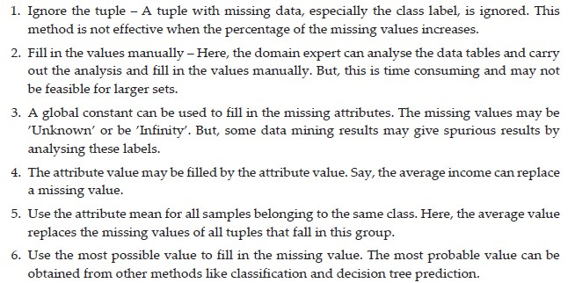
Missing Data

Slide 37
Missing Data
Method | Accuracy | Use Case
Ignore row | Low | Very small missing data
Manual fill | High | Small datasets
Global constant | Low | Quick placeholder
Mean value | Medium | Numerical data
Class-wise mean | High | Labeled data
Most probable value | Very High | ML-based systems

Slide 38
Noisy Data
Noisy data refers to data that contains:
Random errors
Incorrect values
Irregular fluctuations
Noise can reduce the accuracy of Machine Learning models, so we apply data smoothing techniques.

Slide 39
How to reduce Noisy Data?
Binning Technique is also called Data Smoothing
Binning is a technique where:
Data is sorted
Divided into bins (groups)
Values inside each bin are smoothed (adjusted)

Slide 40
How to reduce Noisy Data?
Binning Technique is also called Data Smoothing
Binning is a technique where:
Data is sorted
Divided into bins (groups)
Values inside each bin are smoothed (adjusted)

Slide 41
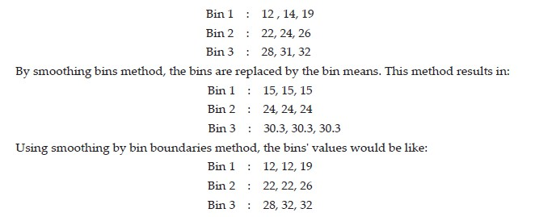
Noisy Data
Given Data

Slide 42
Noisy Data
Method | How it works | Effect
Bin Mean | Replaces all values with average | Strong smoothing
Bin Boundary | Replaces with nearest min/max | Moderate smoothing
Binning is a data smoothing technique used to reduce noise by grouping sorted data into bins and replacing values using bin means or boundaries.

Slide 43
Question Time
Which method changes the data more – bin mean or bin boundary?

Slide 44
Answer Time
Bin mean smoothing changes the data more than bin boundary smoothing.
Reason:
In bin mean, all values in a bin are replaced by the same average value, which can significantly alter the original data.
In bin boundary, values are replaced with the nearest boundary (minimum or maximum), so the original range and structure of the data are better preserved.
Therefore, bin mean causes greater data modification than bin boundary.

Slide 45
Data Normalization
Data normalization is the process of scaling numeric data so that all values fall within a specific range.
This helps ML algorithms work better, especially those based on distance calculations (KNN, SVM, Neural Networks).
1.) Min–Max Normalization
Also called rescaling
Transforms data into a fixed range, usually 0 to 1

Slide 46

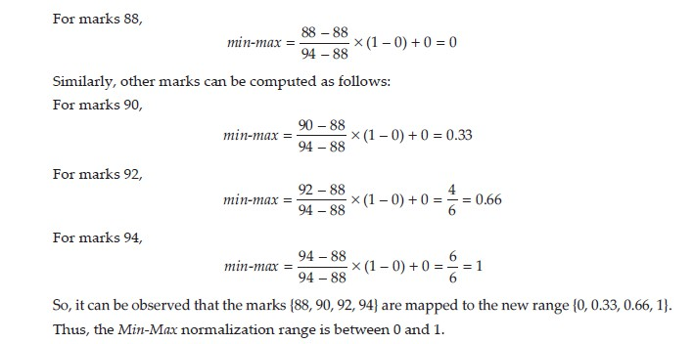
Data Normalization
MIN-MAX PROCEDURE
TRANSFORMS DATA TO THE RANGE 0-1

Slide 47
Why Min-Max Procedure?
Prevents features with large values from dominating the model
Improves model accuracy and convergence
Maintains relative differences between values
Min–Max normalization rescales data to a fixed range (usually 0–1) using the minimum and maximum values of the dataset.

Slide 48
Data Normalization
2. Z-Score Normalization (Standardization)
Converts data to have mean 0 and standard deviation 1
Or
Z-score normalization, also called standardization, scales data so that it has:
Mean = 0
Standard deviation = 1
It shows how far a value is from the mean, measured in terms of standard deviation.

Slide 49
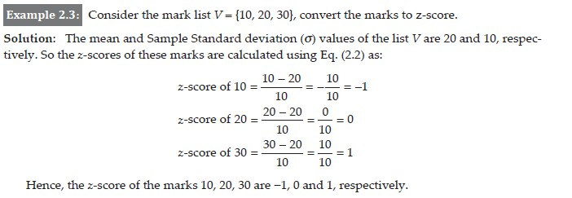
Data Normalization
Z-SCORE Example

Slide 50
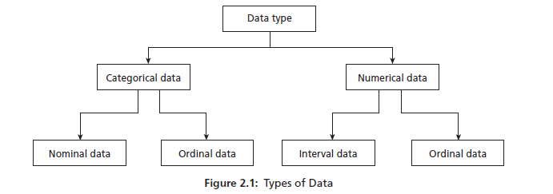
Types of Data
Data can be broadly classified into two main types:
This classification helps us decide which statistical or machine learning methods to use.

Slide 51
Categorical Data
Categorical data represents labels or categories, not numerical values.
Also called Qualitative Data
Categorical data are also of 2 type:-
a) Nominal Data
Categories without any order
Only used for classification
Examples:
Gender (Male, Female)
Blood group (A, B, AB, O)
Colors (Red, Blue, Green)
✔️No ranking
✔️ No mathematical operations

Slide 52
Categorical Data
b) Ordinal Data
Categories with a meaningful order
Difference between values is not measurable
Examples:
Grades (A, B, C, D)
Satisfaction level (Low, Medium, High)
Education level (School < College < University)
✔️ Order matters
❌ Exact difference unknown

Slide 53
Numerical Data
Numerical data represents numbers and supports mathematical operations.
a) Interval Data
Ordered data with equal intervals
No true zero
Examples:
Temperature in Celsius or Fahrenheit
Calendar years
✔️ Addition and subtraction possible
❌ Ratios not meaningful

Slide 54
Numerical Data
b) Ordinal/Ratio Data
Ordered data with equal intervals
Has a true zero
Examples:
Height, Weight
Age
Salary
All mathematical operations allowed
Ratios are meaningful (e.g., double, half)

Slide 55
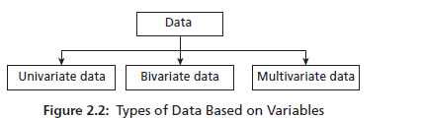
Types of Data
BASED ON VARIABLES:- Based on the number of variables involved, data can be classified into:

Slide 56
Types of Data Example
Type | No. of Variables | Example
Univariate | 1 | Student age
Bivariate | 2 | Height & weight
Multivariate | 3 or more | ML dataset/Person BP,Sugar,cholestrol

Slide 57
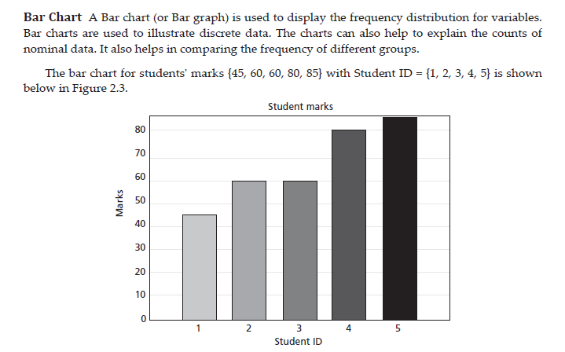
Data Visualization

Slide 58
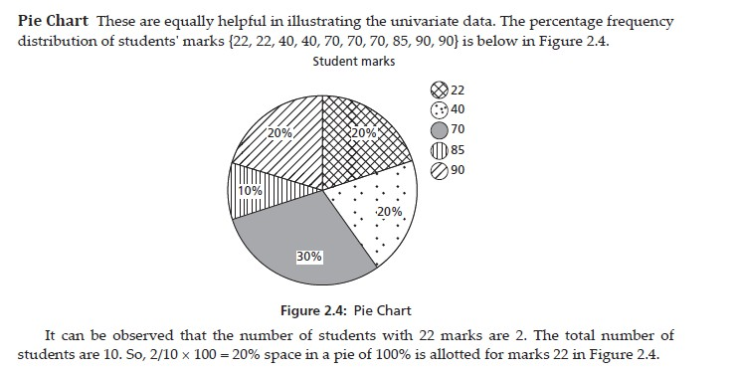
Data Visualization

Slide 59
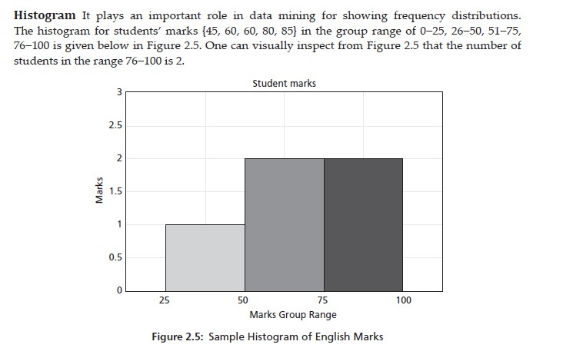
Data Visualization

Slide 60
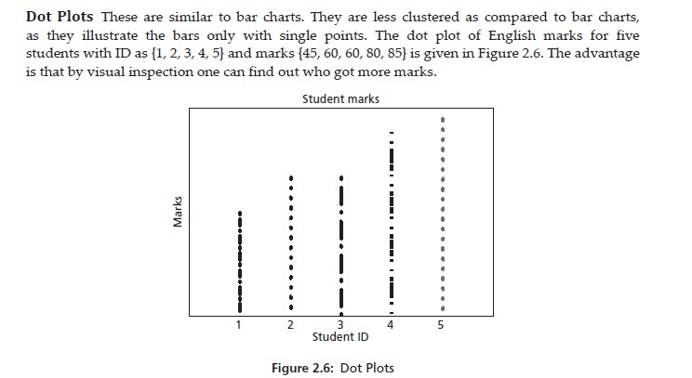
Data Visualization

Slide 61
Data Visualization

Slide 62


Central Tendency
Central tendency refers to a single value that represents the center or typical value of a dataset.
Common measures of central tendency:
Mean
Median
Mode
MEAN OF DATA

Slide 63
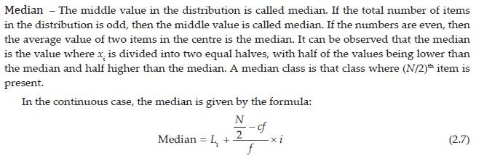
Central Tendency
MEDIAN OF DATA

Slide 64
Central Tendency
MODE OF DATA

Slide 65
DISPERSION
Dispersion refers to how spread out or scattered the data values are around a central value (mean/median).
In ML, dispersion helps us understand data variability, noise, and feature behavior before model training.
Why Dispersion Matters in ML
Identifies data variability and outliers
Helps choose normalization/standardization
Affects distance-based algorithms (KNN, SVM)
Indicates feature stability (low vs high variance)

Slide 66
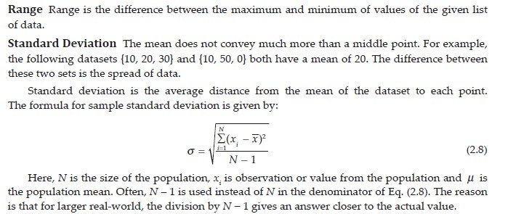
DISPERSION
RANGE AND STANDARD DEVIATION

Slide 67
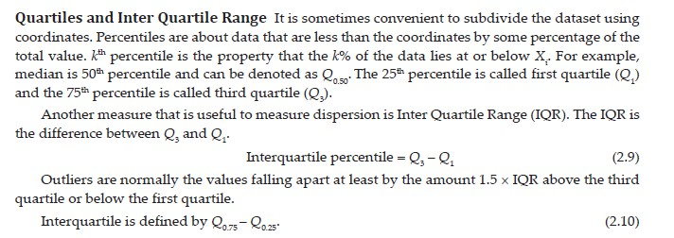
DISPERSION
QUARTILES AND IQR

Slide 68
DISPERSION
High dispersion → data is widely spread → may need normalization
Low dispersion → feature may have low importance
Standard deviation is used in Z-score normalization
Variance is used in PCA for feature selection

Slide 69
Five-point summary
The Five-Point Summary is a way to summarize a dataset using five key values.
It helps us understand the spread, center, and range of the data at a glance.
The five points are always written in this order:
Minimum – smallest value in the data
Q1 (First Quartile) – value below which 25% of the data lies
Median (Q2) – middle value (50% of data on each side)
Q3 (Third Quartile) – value below which 75% of the data lies
Maximum – largest value in the data
Order to remember:
Minimum → Q1 → Median → Q3 → Maximum

Slide 70
Five-point summary
Given data:
{13, 11, 2, 3, 4, 8, 9}
Step 1: Arrange data in ascending order
2, 3, 4, 8, 9, 11, 13
Step 2: Find each component
Minimum = 2
Median = 8 (middle value)
Q1 = 3 (median of left half: 2, 3, 4)
Q3 = 11 (median of right half: 9, 11, 13)
Maximum = 13
Five-Point Summary:
(2, 3, 8, 11, 13)

Slide 71
Box Plot
A box plot is a graphical representation of the five-point summary.
It shows how data is distributed, where most values lie, and how spread out the data is.
How it works:
The box spans from Q1 to Q3
The line inside the box shows the median
The whiskers extend to the minimum and maximum
Why box plots are useful:
Quickly show data spread
Easy comparison between datasets
Helps detect skewness and outliers

Slide 72
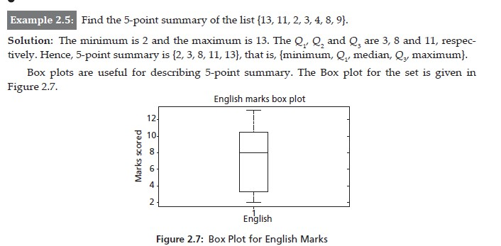
Box Plot

Slide 73
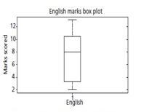
Box Plot
What a box plot tells us
Spread of data → length of box and whiskers
Central tendency → position of the median
Skewness
  Median near centre → symmetric data
  Median closer to bottom/top → skewed data
Easy comparison between different datasets
How the box plot is drawn (step-by-step)
A box is drawn from Q1 (3) to Q3 (11)
A vertical line inside the box shows the median (8)
A lower whisker extends from Q1 to minimum (2)
An upper whisker extends from Q3 to maximum (13)
In the figure, the y-axis shows marks scored, and the box plot summarizes English marks.

Slide 74
Example of Box point
Salary distribution in a company
Daily temperatures in a month
Delivery time of online orders
Rainfall amounts in different seasons

Slide 75
Shape of Data
The shape of data tells us how values are distributed around the center (mean/median).
Two important measures used to describe shape are:
Skewness – direction of the data spread
Kurtosis – peakedness or flatness of the distribution

Slide 76
Skewness
Skewness measures the asymmetry of a data distribution.
Positive Skewness (Right-skewed)
Tail is longer on the right side
Most data values are small
Mean > Median
📌 Real-life example:
Income of people (few people earn very high salaries)
(b) Negative Skewness (Left-skewed)
Tail is longer on the left side
Most data values are large
Mean < Median
Real-life example:
Marks in an easy exam (most students score high)

Slide 77
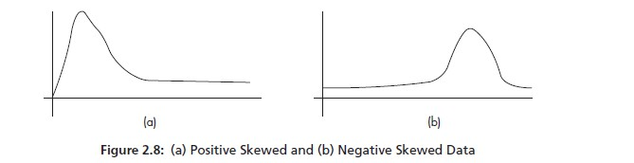
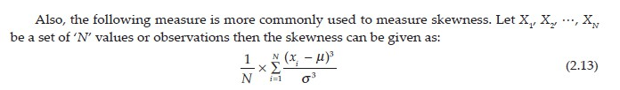
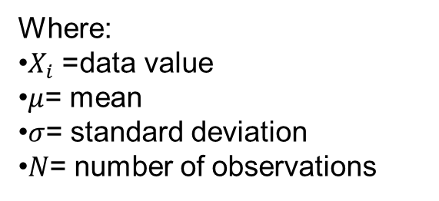
Shape of Data
SKEWNESS AND KURTOSIS
Interpretation:
Skewness = 0 → Symmetric distribution
Skewness > 0 → Positive skew
Skewness < 0 → Negative skew
Where:
$X_{i}$= data value
$μ$= mean
$σ$= standard deviation
$N$= number of observations

Slide 78

Shape of Data
KURTOSIS :- Kurtosis measures the peakedness of data distribution

Slide 79
Shape of Data
Type | Shape | Meaning
Mesokurtic | Normal peak | Balanced
Leptokurtic | Sharp peak | Many extreme values
Platykurtic | Flat peak | Data spread out

Slide 80
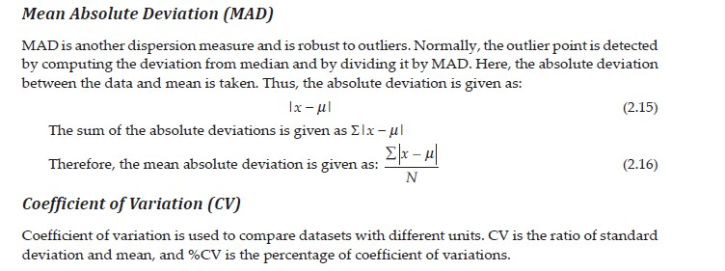
Shape of Data
MEAN ABSOLUTE DEVIATION AND COEFFICIENT OF VARIATION:- These are dispersion measures – they tell us how much data varies around a central value.

Slide 81
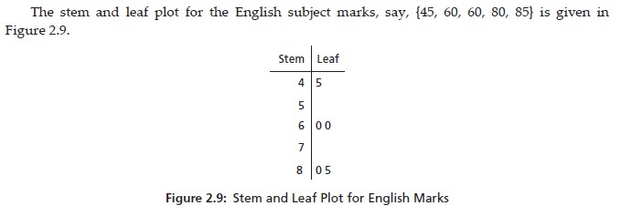
Stem-Leaf Plot
A stem-and-leaf plot is a way to organize and display numerical data while keeping the original data values.
It is useful for small to medium datasets and helps us quickly see the distribution and frequency of data.

Slide 82
Stem-Leaf Plot
Given data (English marks)
45, 50, 60, 60, 80, 85
How to create a Stem-and-Leaf Plot
Step 1: Split each number
Stem → first digit (tens place)
Leaf → last digit (ones place)
Number | Stem | Leaf
45 | 4 | 5
50 | 5 | 0
60 | 6 | 0
60 | 6 | 0
80 | 8 | 0
85 | 8 | 5

Slide 83
Stem-Leaf Plot
Step 2: Arrange in order
Stem | Leaf
4 | 5
5 | 0
6 | 0 0
7 |
8 | 0 5
How to read the plot
4 | 5 → 45
6 | 0 0 → 60, 60
8 | 0 5 → 80, 85
Each row shows how many values fall in that range.

Slide 84
Stem-Leaf Plot
Why Stem-and-Leaf Plot is useful
Retains original data
Easy to find median and range
Shows frequency and distribution
Faster than bar charts for small datasets

Slide 85
Q-Q Plot
Quantile–Quantile Plot
A Q–Q plot is a visual tool used to check whether a dataset follows a normal distribution.
How to read it:
The plot compares
X-axis: theoretical quantiles of a normal distribution
Y-axis: actual quantiles of your data
Each point represents a quantile from your data matched with a normal quantile.

Slide 86
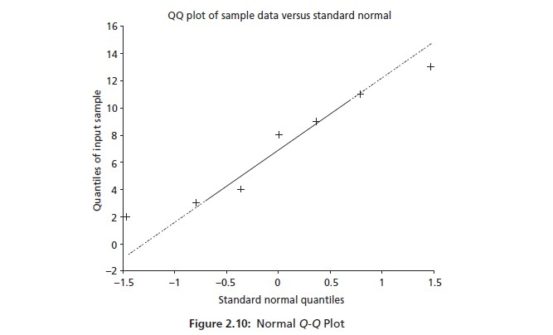
Q-Q Plot
Interpretation:
Points lie close to the straight line → data is approximately normal
Curved pattern (S-shape) → data is skewed
Points deviate at the ends (tails) → outliers or heavy/light tails
Strong systematic deviation → data is not normally distributed

Slide 87
Q-Q Plot
If your data “behaves like” normal data, the dots will nicely follow the line.
If they bend away, something non-normal is going on.
Why it’s useful:
Quick normality check before applying tests like t-test, ANOVA, linear regression
More informative than just a yes/no test
In short,
Closer the points to the straight line → closer the data to normal distribution.

Slide 88
Q-Q Plot Application
Suppose you collect marks of 50 students in a mid-semester exam.
Step 1: What you expect
Usually, exam marks are approximately normal:
Few students score very low
Few students score very high
Most students score around the average
Step 2: Draw a Q–Q Plot
You plot:
X-axis: ideal (theoretical) normal distribution
Y-axis: actual exam marks
Interpretation using Q–Q Plot
Case 1: Points lie close to the straight line
Marks are normally distributed
You can safely apply t-test, ANOVA, regression
Case 2: Points bend upward on one side
Data is skewed
Example: Paper was too easy → many high scores
Case 3: Points deviate at both ends
Outliers present
Example: Few students copied or few left the exam early

Slide 89
Q-Q Plot Example
Another quick real-life examples
Heights of adults → usually straight line (normal)
Daily salary of workers → skewed → curved Q–Q plot
Waiting time at hospital → heavy tail → deviation at ends

Slide 90
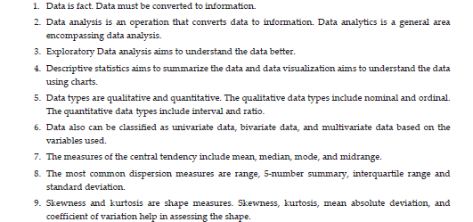
Summary

Slide 91
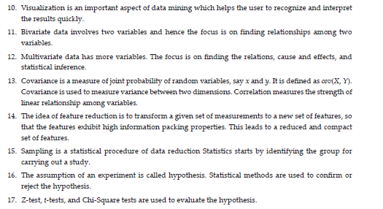
Summary

